Slide 1

UST Global - Healthcare
WGS Accum ODS Recommendations

Slide 2
Overview
Anthem is proposing changes to Accum ODS functioning and here are the vision statements.
Accum ODS should function like a financial system with consistency.
Capture analytics about how well the Accum ODS is functioning.
Treat the Accum ODS like a micro-service to gain autonomy and maintain isolation from other systems changes

Slide 3
Background
The Accumulator Operations Data Store (ODS) is where the out-of-pocket maximum accumulators are shared, are stored. This application will be used to support commingling of cost-shares toward a single out-of-pocket maximum for Anthem products.
Commingling must be indicated on the WGS Contract Profile through group set-up
Membership and product information is electronically transmitted to the Accum ODS including contract codes, accumulation name and benefit limits
Claims reads the Accum ODS in real-time to get current values using Medical Member IDs and processes, subject to the member’s current contract benefits
Accum ODS uses Medical IDs for inquiry and updates
Accum ODS supports P2P transfer when member switches product and his availed accumulator services are transferred to new product if applicable.

Slide 4
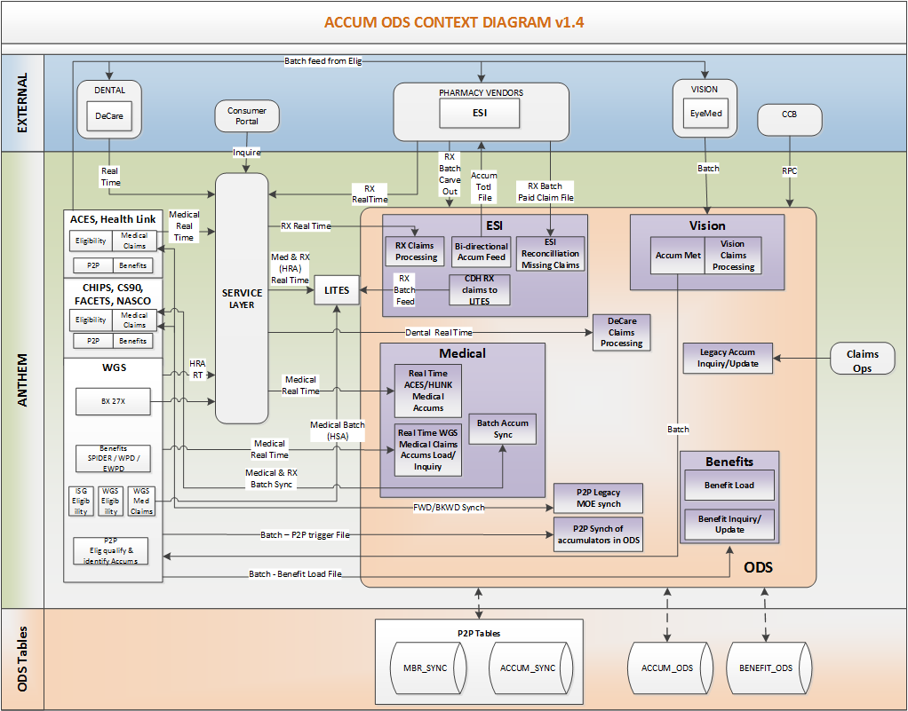
Current State

Slide 5
Problem 1 and Approach
Problem Statement: Current architecture doesn’t track all the accumulator transactions.
Cause | Resolution | Next Step
SPLUNK(the product used in SOA) is not registering all the transactions in the SOA layer | Tracking, Auditing, Reporting of transactions should be introduced at the back end, SOA layer may not capture all the transactions. | Come up with a design
Accum updates are done directly through batch feeds and mainframe | Introduce auditing at the Accums back-end level

Slide 6
Problem 2 and Approach
Problem Statement:
Duplicate records are getting updated in accumulator ODS creating incorrect claim payments resulting in adjustments.
Cause | Resolution | Next Step
During the real time updates from different systems, when the response is slow, source system might be informed with failure status as services have a cut off time to get the response. Because of this, source system will retry the transaction which results in double updates. | Check Network Latency is due to SOA middle layer or application processing time. | Based on the findings come up with design
Peripheral application availability is causing accum call to fail from ESI, those applications don’t have direct dependency on the accumulator update | Remove IMS PCBs from Service Transactions from ESI and make it independent | Come up with design

Slide 7
Problem 3 and Approach
Problem Statement:
Source specific business logic in the accum ODS IO layer. This is against the guiding principles of autonomy and isolation from source system changes.
Cause | Resolution | Next Step
Source system limitations has forced those business logic to be part of IO layer | Isolate source systems logic from IO layer and move to source system. | Create Inventory identifying the source specific logic and involve source systems to incorporate those changes.

